Slide 1
Lesson 1
Introduction to Web Application Architecture
Well begun is ½ done
Notes:
last update: 4/3/2013

Slide 2
Web Application Architecture
This course is concerned with the realization of scalable web applications as defined by a Web Application Architecture.
And a Web Application Architecture
is a part of an Enterprise Architecture
So focus is a Scalable Web Application that is an Enterprise Application…
It is an application - that is large & complex –
well beyond the individual or small business use case.
“…for creating large-scale business applications, you need …[to understand] the design and architecture of enterprise applications…“
Enterprise Design & Architecture - Microsoft

Slide 3
Course Focus
So, in this course we will focus on
Architecture, an abstract plan that includes design patterns, modules, and their interactions.
we will investigate
Implementation or Realization of a Presentation Layer Architecture
which [can] incorporate a
Framework - architected "physical" structures on which to build an application.
specifically we will use
The Spring Framework, an Enterprise Application Development Environment for building large scale enterprise applications.

Slide 4
Enterprise Architecture
ENTERPRISE CUSTOMER INTEGRATION
Enterprise Policy & Practices Coordination
Campaign Tracking
Prospecting/Lead
Tracking
Enterprise Customer Business Rules Management
Product Cross-Sell Tracking
Service Commitment
Tracking
Sales and
Service
Platforms
Enterprise Business Integration Services
Business Decisioning Support
Platforms
ATM
Customer Profiling
Enterprise Customer
Contact Services
Enterprise Referral Services
Risk Management Services
Kiosk
Enterprise Lead Services
Fraud Services
Industry
Standards
Industry
Standards
Privacy Services
Relationship Sales & Deals
(customized for customer)
Customer Request Services
Payment & Value Transfer Services
Kiosk
Enterprise Business Rule Engines
Profile Indicator Services
Customer Analytic/
Decisioning
Financial Plan Modeling
(customer self-service or WF agents)
Credit Decisioning
Loan Calculator
Sales/Pricing Configuration
Credit Indicator Services
Call Center
Enterprise Integrated Information for Sales & Service
Enterprise Integrated Info. For Analysis
Enterprise
Customer
Info & Rel.
Enterprise
Customer
Account
Summary
Enterprise
Customer
Contact
Enterprise
Referral
Customer
Request
Status
Enterprise
Sales/Deals
Enterprise
Product
Catalog
Enterprise
Org/WF
Rep
Enterprise
Leads
Enterprise
Data
Warehouse
Enterprise
Datamarts
Voice
Response
Teller
Industry
Standards
Access and
Usage of
Enterprise
Services and
Information
Industry
Standards
Cross-
Business
Information
Agents
Industry
Standards
Contribute
to/Use
of Analysis
Results
Store
PRODUCT/SERVICE SYSTEMS (internal, outsource & partnership/alliances)
Field Rep
Internet
Cross Business Infrastructure Services
Common Distributed Infrastructure
Cross Business Messaging Srvcs.
Event Notification Services
Directory Services
Delivery Channel Services
Wireless Services
Cross-System Transactional Services
Data Services
(database/file)
Data Distribution Srvcs
Data Replication
Data Access
Data Trans./Conversion
Execution Services (S/w, H/w)
Object Brokering
Web Server
Application Server/OTM
Message Transports, Parsers
Load balancing Tools
Transactions
Core Infrastructure Services
Network
Naming Services
Operating Systems
Platform Security
Platform Systems Management
Security
Analytic Services
Alert Services
Enterprise Workflow Services
Enterprise Communication Srvcs
Data Warehouse Services
Hardware
Directory Structures
Backup/Recovery
Database
Systems Mngmt
Capability Stage:
Direction – No Progress
Initial: limited strategic functionality; production pilots or single LOB/channel use
Expanded: increased strategic functionality; limited Enterprise Information populated and used by a few LOBs/channels
Advanced: full strategic functionality; Enterprise Information populated by many LOBs; wide production use
Key:
Enterprise Shared, must
contribute & use
Business Line options with
integration requirements
Enterprise Standard - could be
more than one product
Notes:
Identify Workflow rules engine I/O sources EOD, SOD batch reporting SOA microservices COS software, Cross cutting
MANY DBs…MANY LOBs

Slide 5
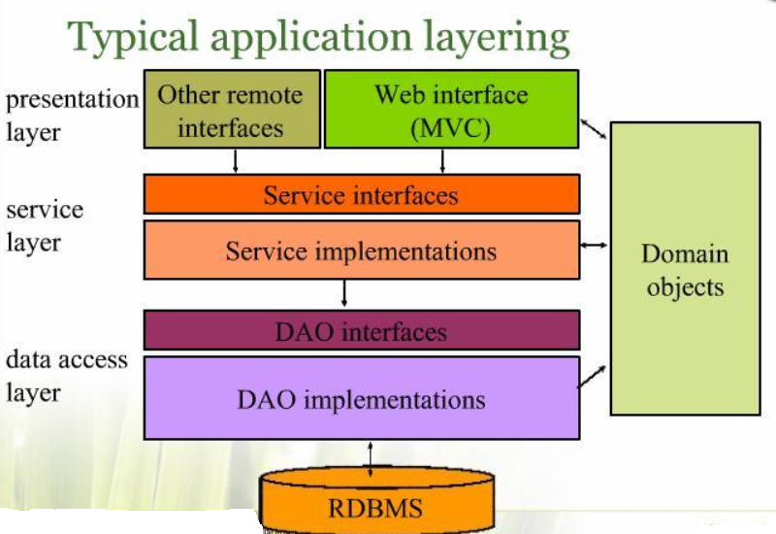
Underlying N-Tier Software Architecture
Separation of Concerns
Domain Model
central, organizing component
Design to Interfaces
Notes:
https://docs.microsoft.com/en-us/dotnet/standard/modern-web-apps-azure-architecture/common-web-application-architectures

Slide 6
Interface Driven Design
ALWAYS design to Interfaces
Interface Driven
Basic Design Pattern
Separation of Concerns
Testability
Scalability
Adaptability
Program to an interface not an implementation
Clients remain unaware of the specific types of objects they use, as long as the object adheres to the interface
clients remain unaware of the classes that implement these objects; clients only know about the class defining the interface
GoF: Design Patterns

Slide 7
“Types” of N-Tier architectures
Monolith
Single Project
Single Presentation layer
Boundaries between tiers “blur” over time
Technical Functional Layering
Project per functional layer [Presentation, Service,
Persistence, Domain]
Increase re-use
Clean layer separation
more flexible….scalable
Component Services Business
Project per business domain
“Services” oriented

Slide 8
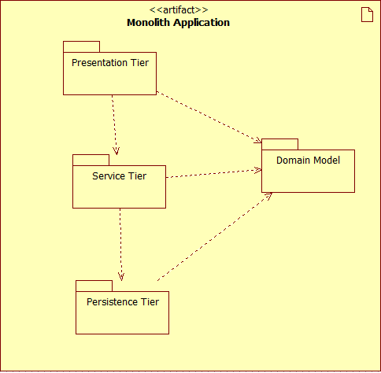
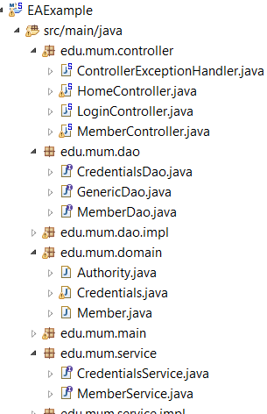
Monolith N-Tier

Slide 9
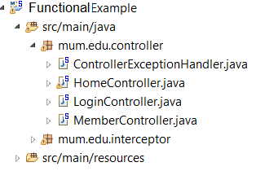
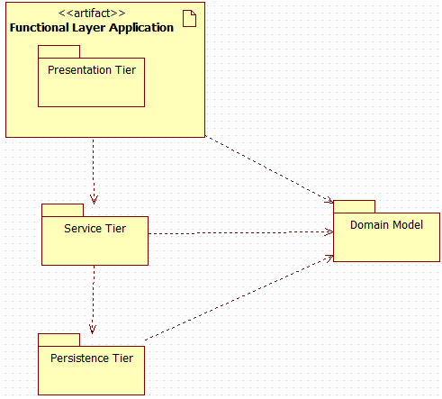
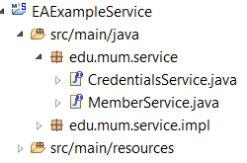
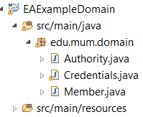
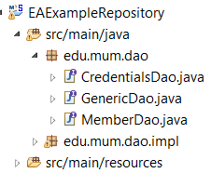
Functional N-Tier

Slide 10




Component N-Tier

Slide 11
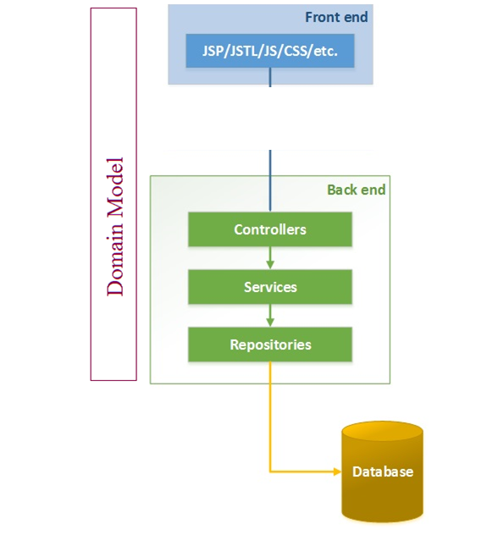

MVC & the N-tier architecture
MVC is the primary “pattern” associated with the presentation tier in the N-tier Architecture
“Classic” Spring MVC
It is commonly identified as page rendering on the server [SSR]
VIEWS
JSP
Velocity
FileMarker
ThymeLeaf
PDF
Excel
Web Flow
JSF
XML
JSON
View

Slide 12
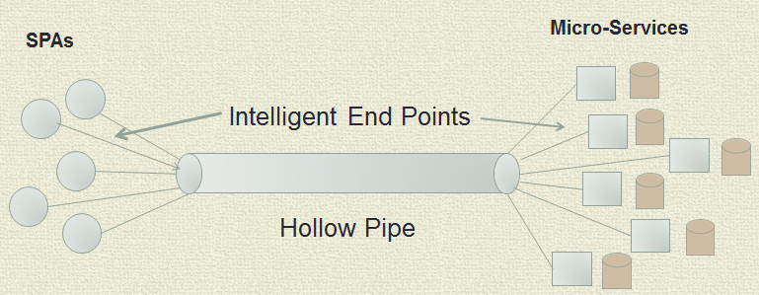
The SPA - Microservice
Alternative
The growth of the Consumer Web
AKA “Digital Business Space”
has emphasized alternative solutions
Specifically:
SPA & Microservices Technologies

Slide 13
SPA & Microservices
Definitions
SPA (A single-page application)
application fits on a single web page with the goal of
providing a more fluid user experience akin to a
desktop application.
Microservices
Built as a suite of modular services.
Microservice ==
single business goal
simple, well-defined communication interface
runs a unique process
manages[usually] its own database.
Initial Target:
LARGE WEB application
High Page Volume
The Guardian newspaper ::
Spring/Spring MVC/Hibernate/Oracle “Monolith”
25 million users
218 million pages
Uber difficult
AKA == SOFEA – Service Oriented Front End Architecture
WHICH MEANS you can NOT have SPA WITHOUT an SOA
XXXX → microservices
Notes:
This not only provides development teams with a more decentralized approach to building software, it also allows each service to be deployed, re-built, re-deployed and managed independently.

Slide 14


Modern High End
Consumer Web
SPA technologies[JavaScript MVC]
Angular, Backbone.js,
Ember.js,CanJS, React
Micro-Services
SPAs
Intelligent End Points
Hollow Pipe
High Page Volume Ultra Many Users
“Primary” Candidates
Internet companies – web page IS product
Facebook, Instagram, Twitter, AccuWeather
Internet Companies – with “products to sell”
Netflix, Amazon
Brick & Mortar with LARGE internet presence
Walmart
You are Not Netflix: How and when to use Microservices in the Enterprise
Hollow Pipe/Services
Node.js, Play2.0/Scala
Spring Framework/Microservices

Slide 15
Spring & Spring MVC
Consumer Web relatedTechnologies
XXXX → microservices
Spring MVC – view agnostic
REST service support –
easily integrates with SPA.
Mobile device support
Integrated Web security
Spring Data
Supports RDMS
Supports NOSQL
WebSocket support
Spring Boot - fast prototype/microservices delivery
Cloud delivery

Slide 16
SPA & Microservices in the Enterprise
Every enterprise application is not:
AMAZON
Building large, complex applications is inherently difficult
Microservices [& SPA] are additional tools for handling quick turn around & scalability
especially in the “Digital Business Space”
Often viewed as a fix for the Monolith
However it introduces its own set of complexities and implementation challenges
FACEBOOK
Poorly-implemented microservices can have the same shortcomings of a monolith, but with the added complexity of managing many independent distributed services
WALMART “online”
NETFLIX

Slide 17
Core N-Tier Enterprise Architecture
Position Statement
Corporate Enterprise Environments are an
Of Technologies
A “Java/Spring” shop is “maybe” 70-80% Java
New technologies arise to solve new use cases
Example: SPA/Microservices Architecture
However, a new technology is not a wholesale solution for
the core enterprise software infrastructure
So Our Focus will be:
Enterprise := N-Tier Architecture
“OLIO”

Slide 18
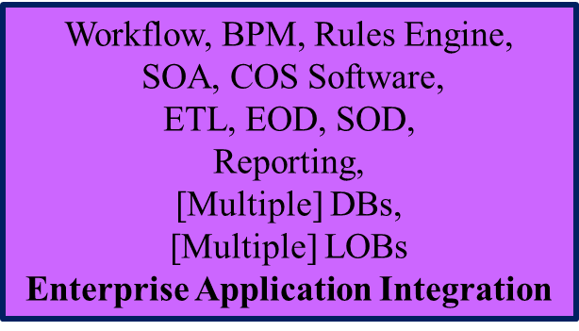
Enterprise Architecture
ENTERPRISE CUSTOMER INTEGRATION
Enterprise Policy & Practices Coordination
Campaign Tracking
Prospecting/Lead
Tracking
Enterprise Customer Business Rules Management
Product Cross-Sell Tracking
Service Commitment
Tracking
Sales and
Service
Platforms
Enterprise Business Integration Services
Business Decisioning Support
Platforms
ATM
Customer Profiling
Enterprise Customer
Contact Services
Enterprise Referral Services
Risk Management Services
Kiosk
Enterprise Lead Services
Fraud Services
Industry
Standards
Industry
Standards
Privacy Services
Relationship Sales & Deals
(customized for customer)
Customer Request Services
Payment & Value Transfer Services
Kiosk
Enterprise Business Rule Engines
Profile Indicator Services
Customer Analytic/
Decisioning
Financial Plan Modeling
(customer self-service or WF agents)
Credit Decisioning
Loan Calculator
Sales/Pricing Configuration
Credit Indicator Services
Call Center
Enterprise Integrated Information for Sales & Service
Enterprise Integrated Info. For Analysis
Enterprise
Customer
Info & Rel.
Enterprise
Customer
Account
Summary
Enterprise
Customer
Contact
Enterprise
Referral
Customer
Request
Status
Enterprise
Sales/Deals
Enterprise
Product
Catalog
Enterprise
Org/WF
Rep
Enterprise
Leads
Enterprise
Data
Warehouse
Enterprise
Datamarts
Voice
Response
Teller
Industry
Standards
Access and
Usage of
Enterprise
Services and
Information
Industry
Standards
Cross-
Business
Information
Agents
Industry
Standards
Contribute
to/Use
of Analysis
Results
Store
PRODUCT/SERVICE SYSTEMS (internal, outsource & partnership/alliances)
Field Rep
Internet
Cross Business Infrastructure Services
Common Distributed Infrastructure
Cross Business Messaging Srvcs.
Event Notification Services
Directory Services
Delivery Channel Services
Wireless Services
Cross-System Transactional Services
Data Services
(database/file)
Data Distribution Srvcs
Data Replication
Data Access
Data Trans./Conversion
Execution Services (S/w, H/w)
Object Brokering
Web Server
Application Server/OTM
Message Transports, Parsers
Load balancing Tools
Transactions
Core Infrastructure Services
Network
Naming Services
Operating Systems
Platform Security
Platform Systems Management
Security
Analytic Services
Alert Services
Enterprise Workflow Services
Enterprise Communication Srvcs
Data Warehouse Services
Hardware
Directory Structures
Backup/Recovery
Database
Systems Mngmt
Capability Stage:
Direction – No Progress
Initial: limited strategic functionality; production pilots or single LOB/channel use
Expanded: increased strategic functionality; limited Enterprise Information populated and used by a few LOBs/channels
Advanced: full strategic functionality; Enterprise Information populated by many LOBs; wide production use
Key:
Enterprise Shared, must
contribute & use
Business Line options with
integration requirements
Enterprise Standard - could be
more than one product
Notes:
Identify Workflow rules engine I/O sources EOD, SOD batch reporting SOA microservices COS software, Cross cutting
MANY DBs…MANY LOBs

Slide 19
Web Applications in an
N-Tier Enterprise Architecture
The enterprise is characterized by internal task & process oriented applications [ AKA intranet applications]:
Customer Service - Call Center
Sales
Consumer Site Content Management
EOD, SOD, ETL, COS
Work Flow, BPM, Rules Management
Reporting
HR, Accounting, Employee benefits…
etc., etc.. etc …
Web Applications “abound” across the N- Tier Enterprise…

Slide 20
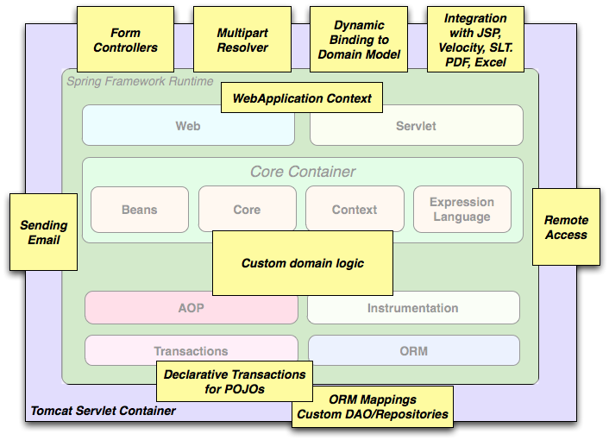
Spring N-tier Architecture
CS 545 WAA Focus
85%
15%
Notes:
FOCUS on Monolith

